Slide 1


Read Write Inc Phonics

Slide 2


Slide 3

Pure sounds
Sounds not names
Lower case not upper case

Slide 4
RWI Phonics programme
► Phonemes (sounds) taught in specific
order
► Children taught to blend the sounds
together to read a set of words; at, mat,
sat, dad, mad + sad
► Reading books linked to each step

Slide 5
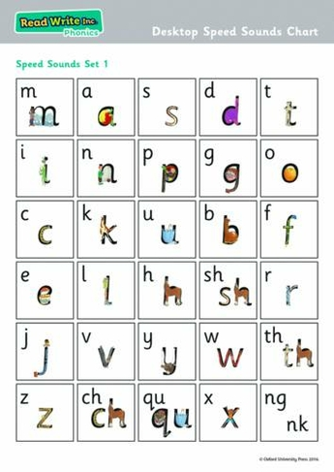
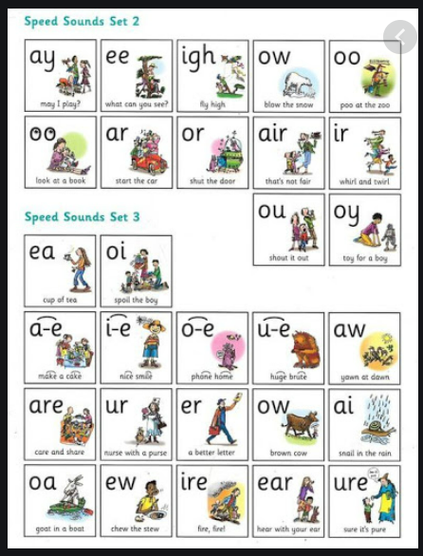

Slide 6

Phonics Screen

Slide 7
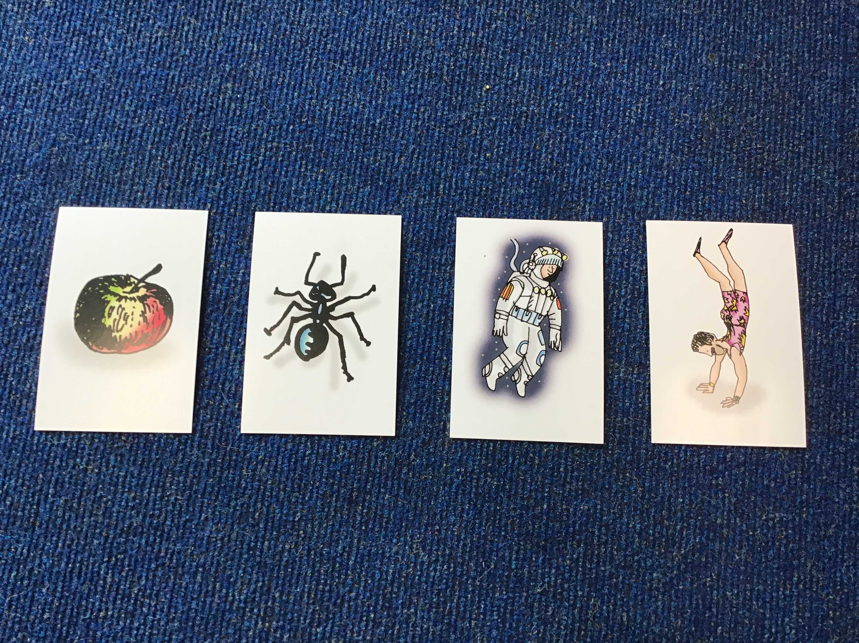

Typical Phonics session
Introduce new sound

Slide 8
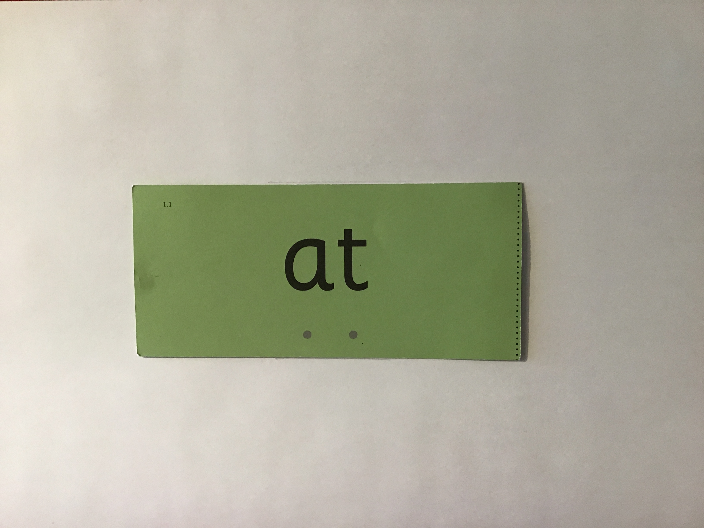
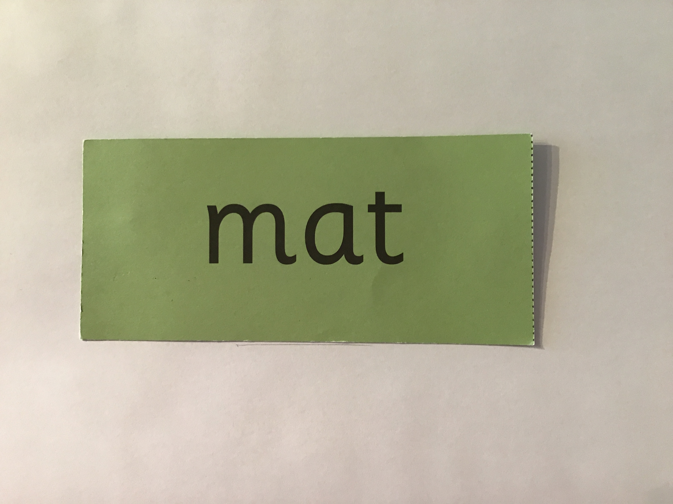
Typical Phonics session
Word Time practice
Speed writing practice

Slide 9
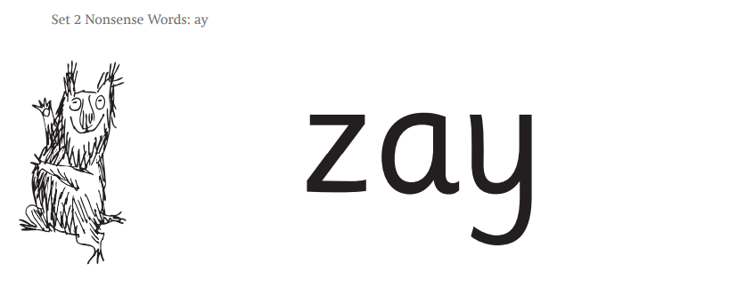

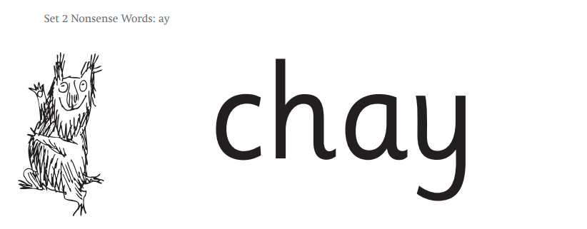
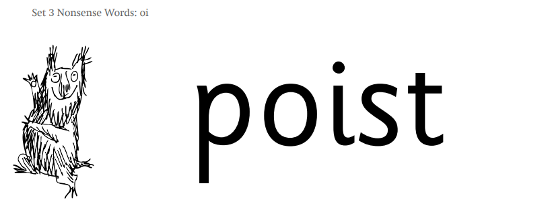
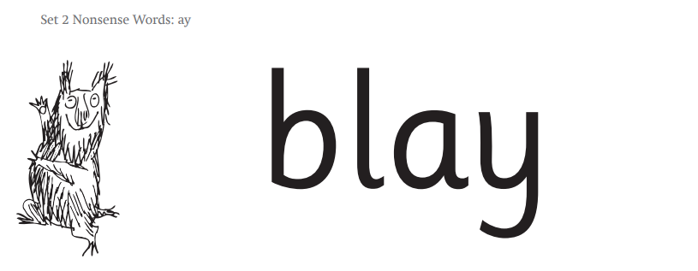

Alien Words

Slide 10
Spelling and Writing
Letter patter for each sound
Fred fingers for spelling – sounds in each word not letters (segmenting)

Slide 11
Red Words
► Words that cannot be sounded out
► Explore the ‘tricky’ part of the word;
you (yoo), said (sed)
► Taught through year and in each year group

Slide 12
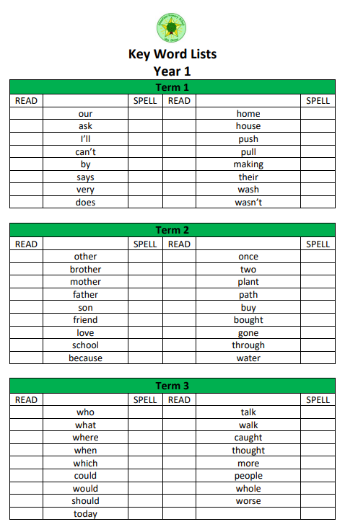
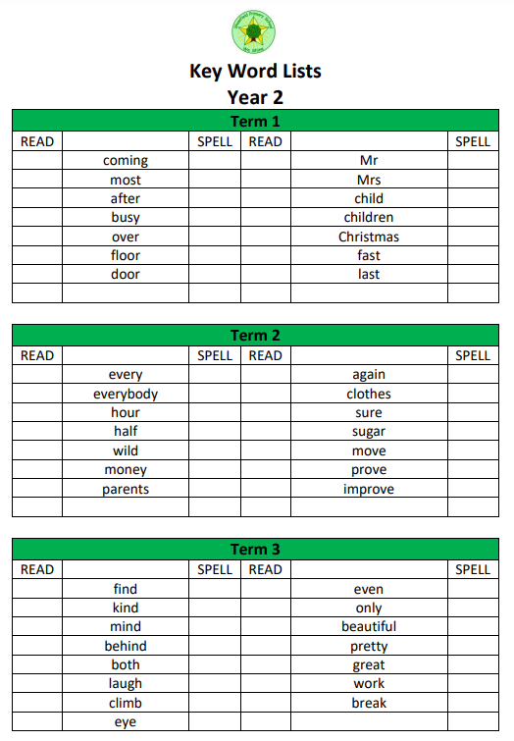
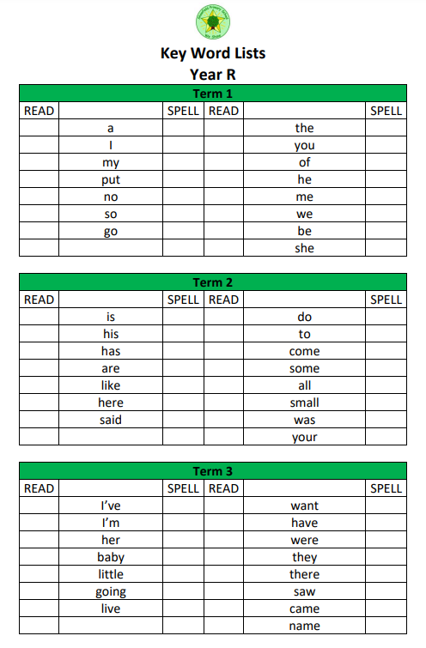

Slide 13
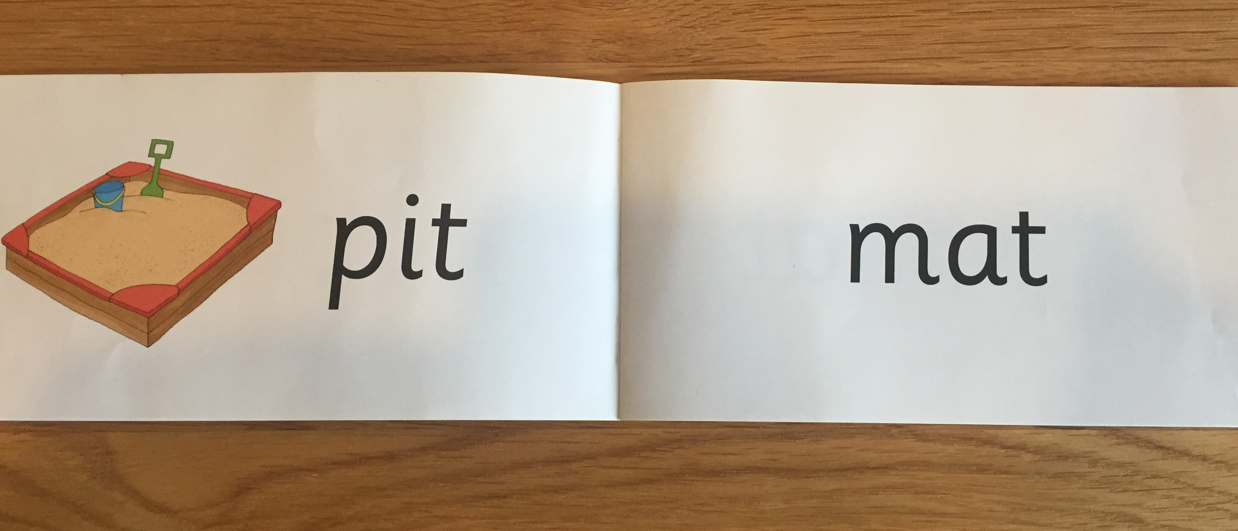
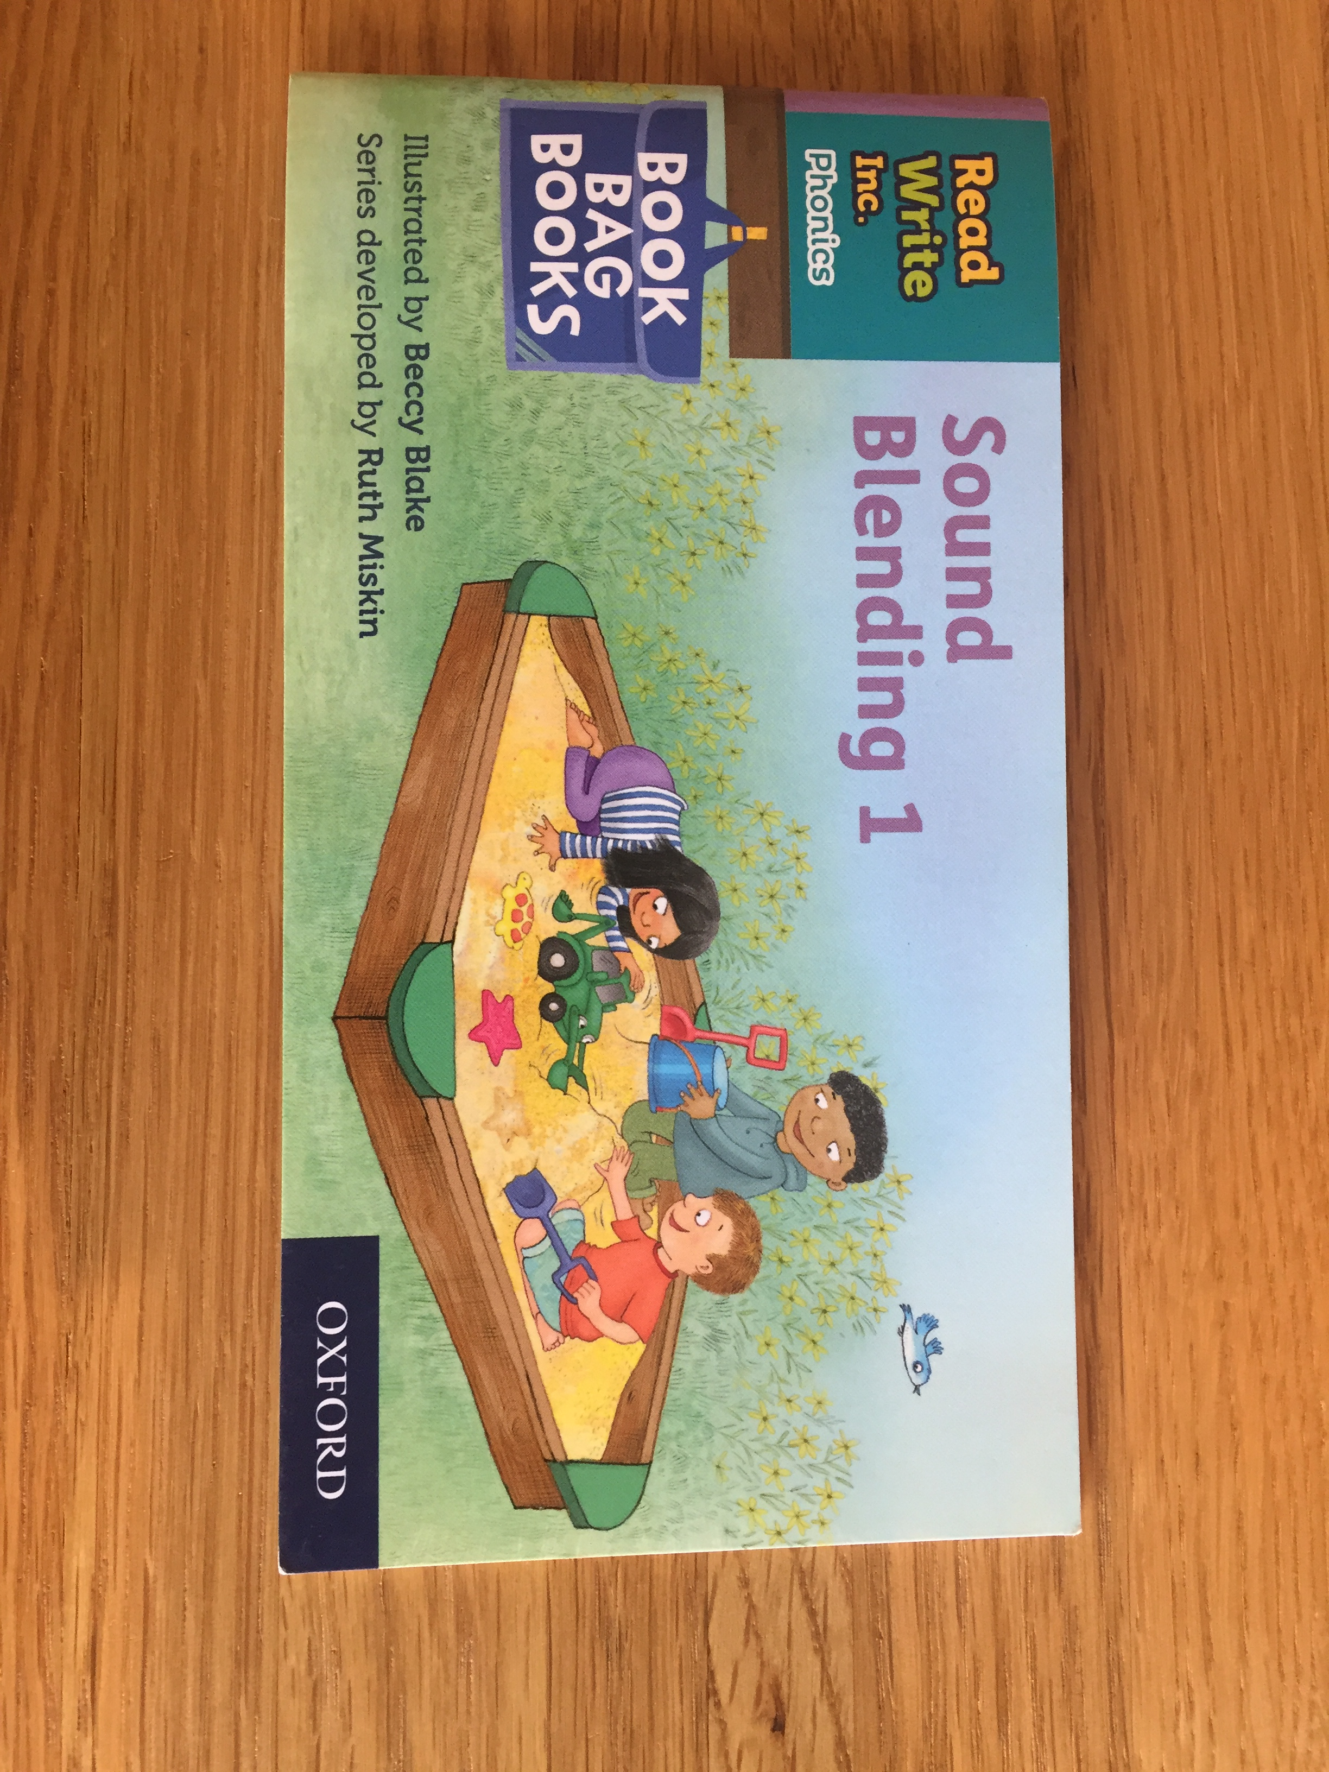
Reading Books

Slide 14
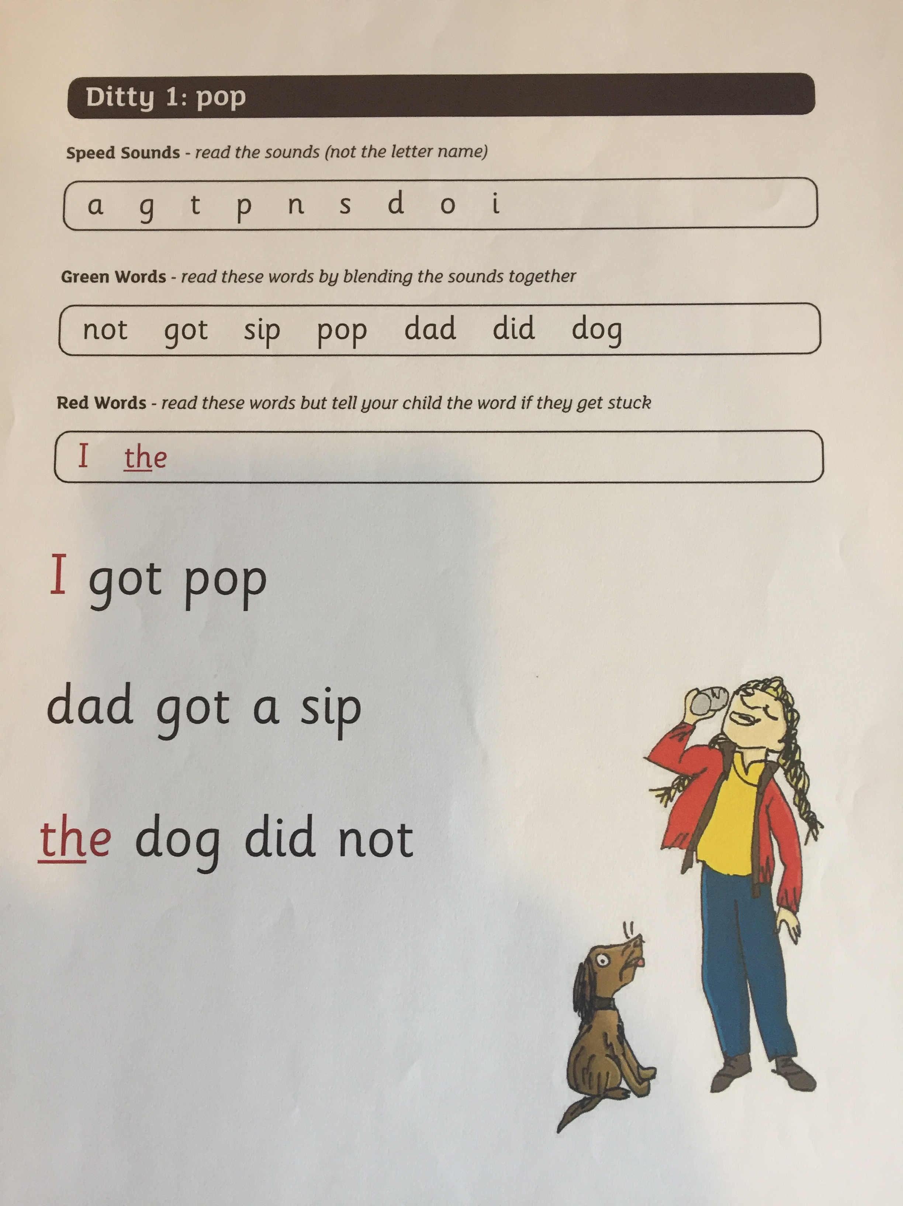

Slide 15
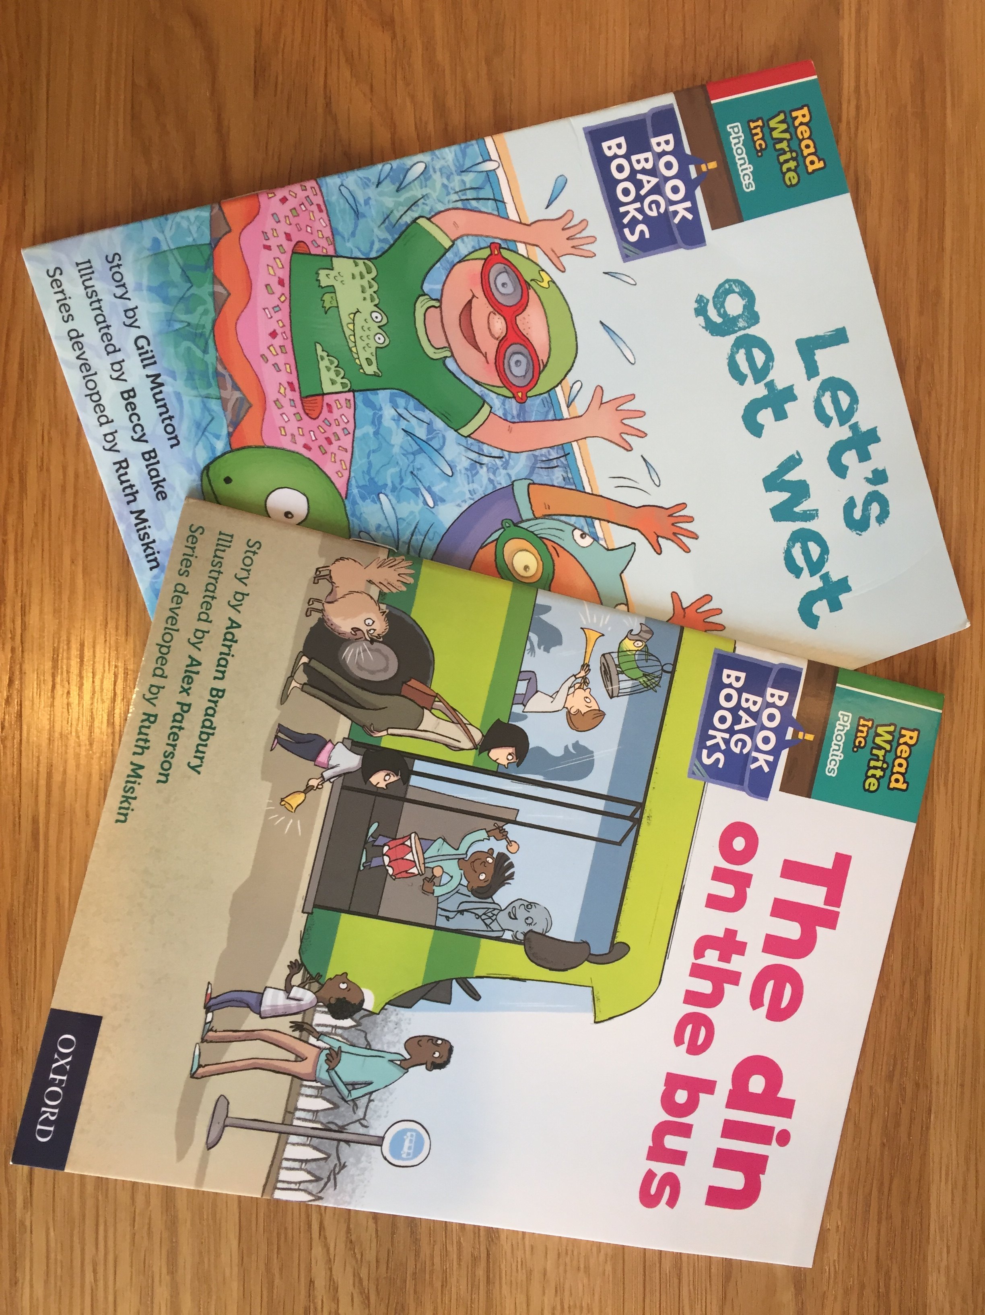

Slide 16

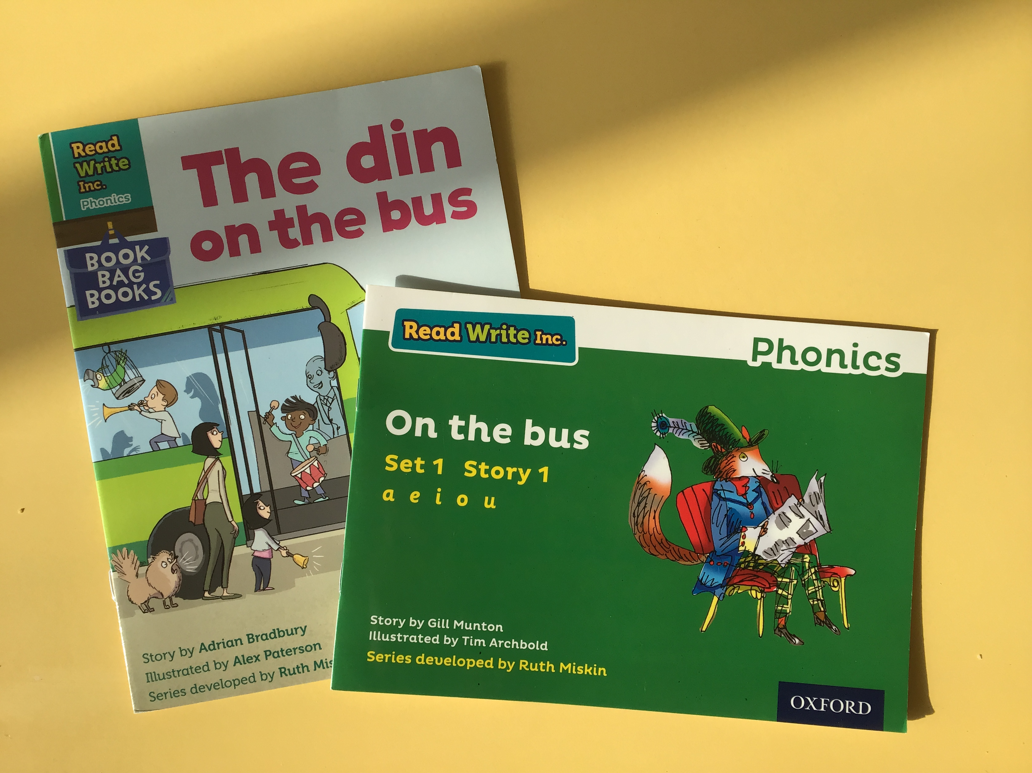
Reading Books
RWI book
Book band book
Free choice from library

Slide 17
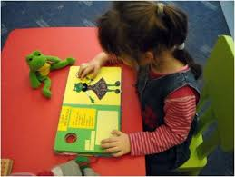
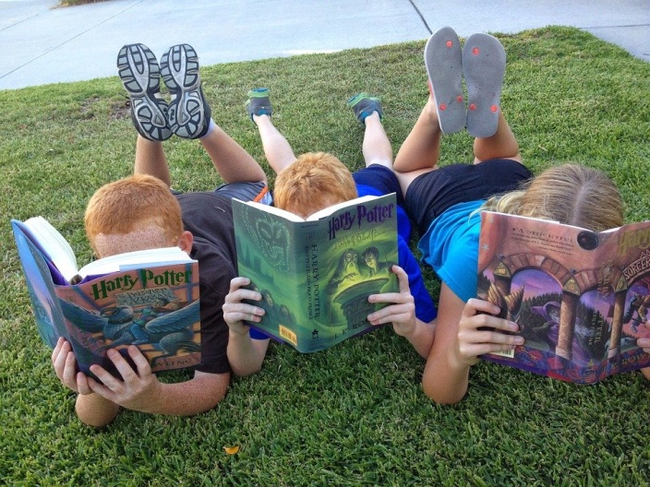
* Read to your child (variety!)
* Listen to them read
* Practise any sounds or spelling patterns that your child is finding difficult
* Practise reading red words
* Be ready practise them often!
* Ask for help if you are unsure
* Talk about books
* Try reading alien words
What can I do to help child?

Slide 18

Questions?

