Slide 1

Teaching Maths for Mastery at Shawfield Primary School
Thursday 21st November

Slide 2
Our evening
What is teaching for mastery?
Teaching for mastery in your child’s class. An opportunity to look at workbooks and resources used in lessons.

Slide 3

Maths at Shawfield Primary School
In previous years , we have used a range of schemes including Big Maths.
From September 2019, all teachers have been using a mastery approach. The school have invested in the Maths No Problem Scheme and all children from Year 1-Year 5 have a workbook that they have started using in lessons. Reception and Year 6 will follow the White Rose scheme.
Shawfield are part of a TRG (Teacher Research Group). Two members of staff meet with other schools in the local area to discuss ways of improving teaching for mastery. A mastery specialist will visit our school once a term to monitor our progress and guide us as a school on how we can improve further.

Slide 4

What is Maths Mastery?
Approach to maths teaching that has originated from Asian nations such as Singapore.
It is designed to help children develop a deep, long-term and adaptable understanding of maths.
Lessons are taught using an inclusive approach where all children achieve.
Slower pace which results in greater progress.
Differentiation occurs through depth rather than acceleration.

Slide 5
“The intention of these approaches is to provide all children with full access to the curriculum, enabling them to achieve confidence and competence – ‘mastery’ – in mathematics, rather than many failing to develop the maths skills they need for the future.”

Slide 6

The CPA Approach
Concrete, Pictorial, Abstract (CPA) is an approach that develops a deep and sustainable understanding of maths that is used within the Singapore method of teaching for mastery.
Children find maths difficult when it is abstract. The CPA approach builds on children’s existing knowledge by introducing abstract concepts in a concrete and tangible way.
It involves moving from concrete resources, to pictorial representations, to abstract symbols and problems.

Slide 7

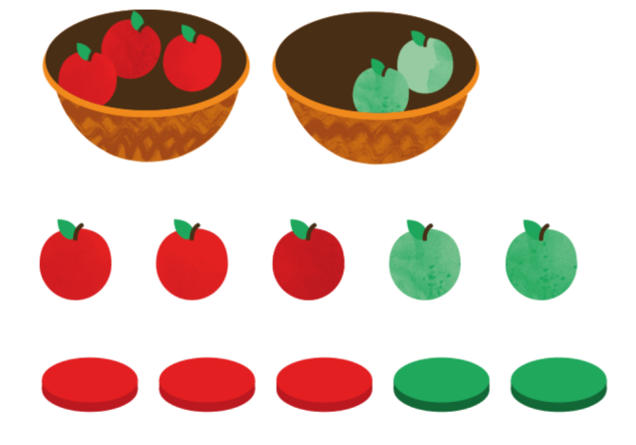
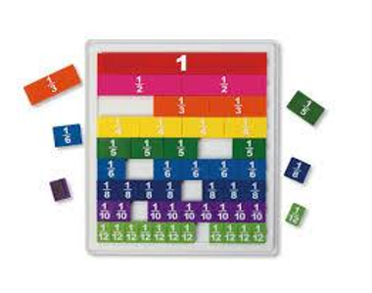
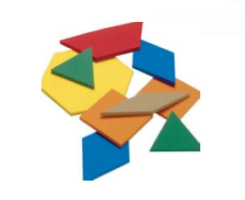

Concrete
The ‘doing’ stage.
A child is first introduced to a concept using and handling real objects.
If children are solving a problem about fruit they will start solving the problem using real life objects/fruit toys before moving onto using counters that represent the fruit.

Slide 8
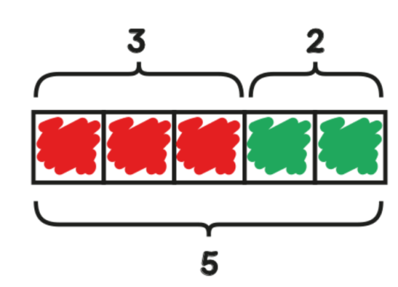
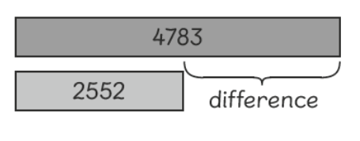
Pictorial
This is the ‘seeing’ stage.
Visual representations are used as a starting point for mathematical discussions and to model how to solve problems.
This stage allows children to make a mental connection between the concrete object and pictorial representation.

Slide 9
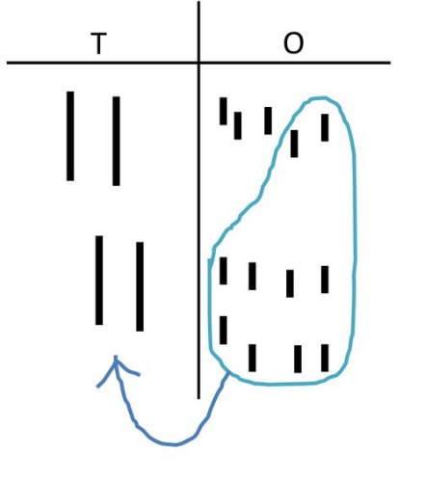
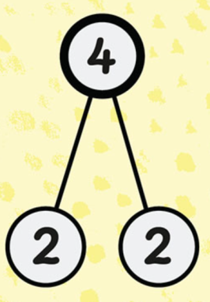
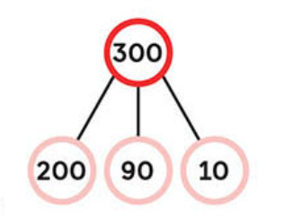
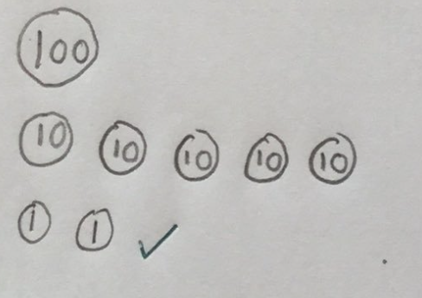
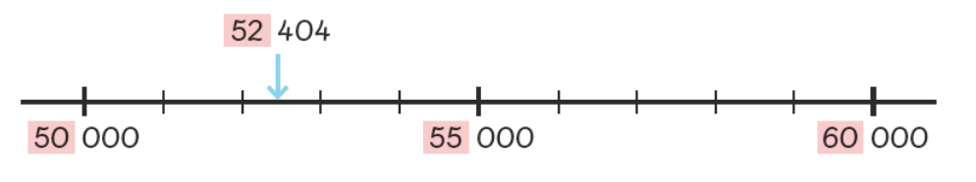
Pictorial Representations
Drawing out place value/dienes

Slide 10
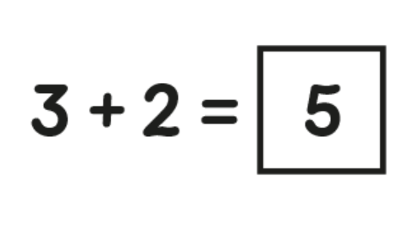
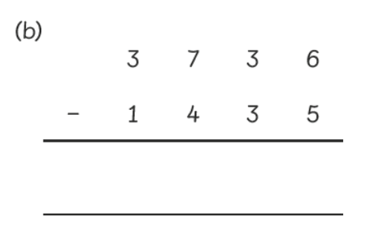
Abstract
This is the ‘symbolic’ stage.
Children need to have a good understanding of the concrete and pictorial stages before moving on to the abstract.
This is the stage where only numbers and symbols are used.

Slide 11
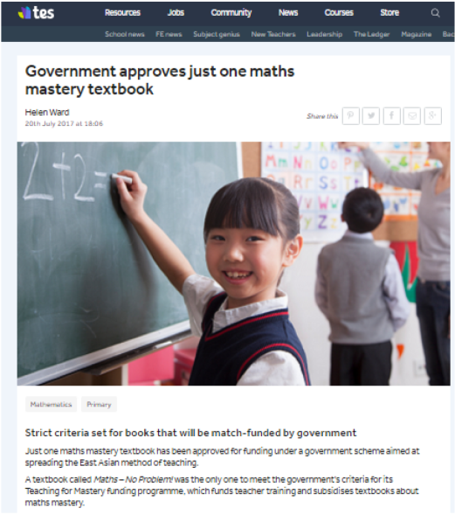
How do we teach Maths Mastery at Shawfield?
From September 2019 Years 1-5 have been using Maths No Problem.
Maths No Problem approved teaching for mastery scheme.
From September 2019 Year R and 6 have been following the White Rose Hub planning.
Concrete resources on hand.
A range of representations modelled to help the children understand the mathematical structure.
Small steps of learning and lessons with a sharp focus, leading the children to achieve a good depth of understanding.

Slide 12

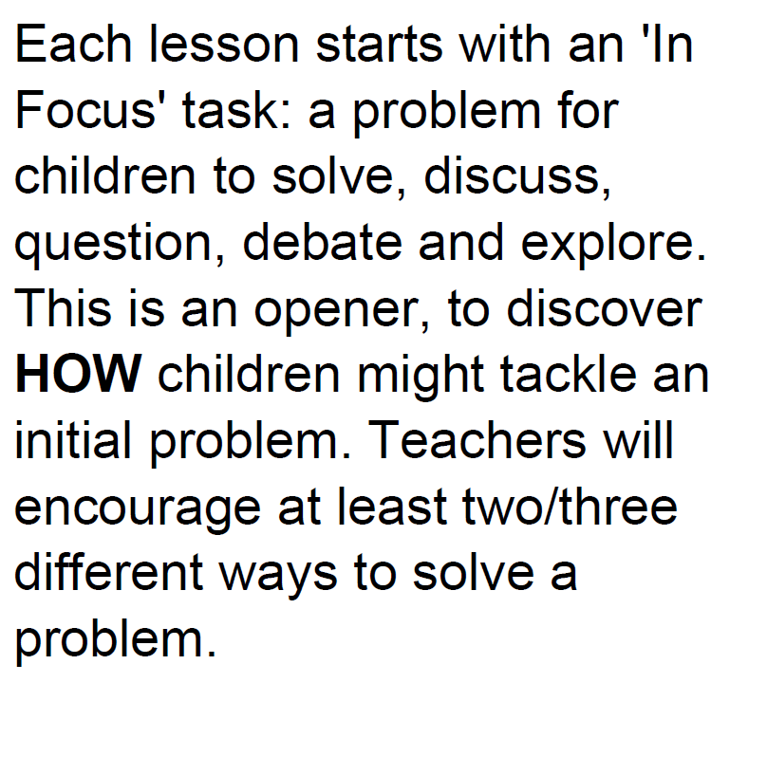



What does the structure of a lesson look like?
Challenge
Plenary Bubble

Slide 13
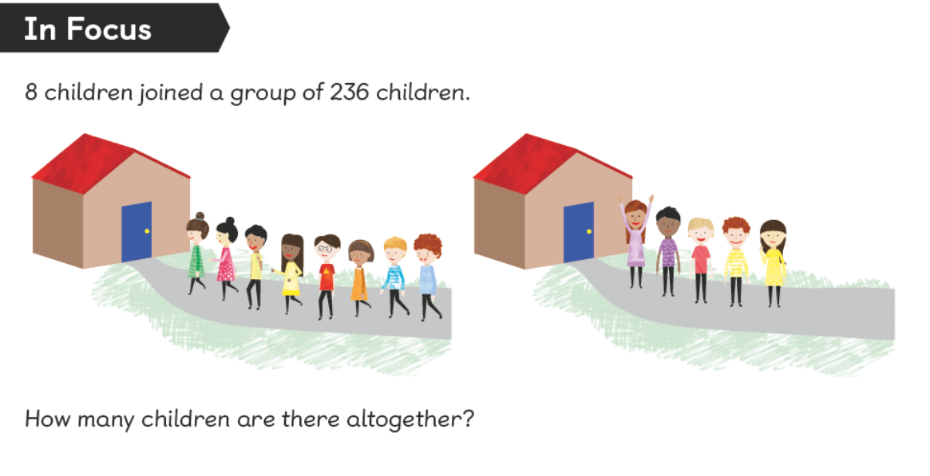

Slide 14
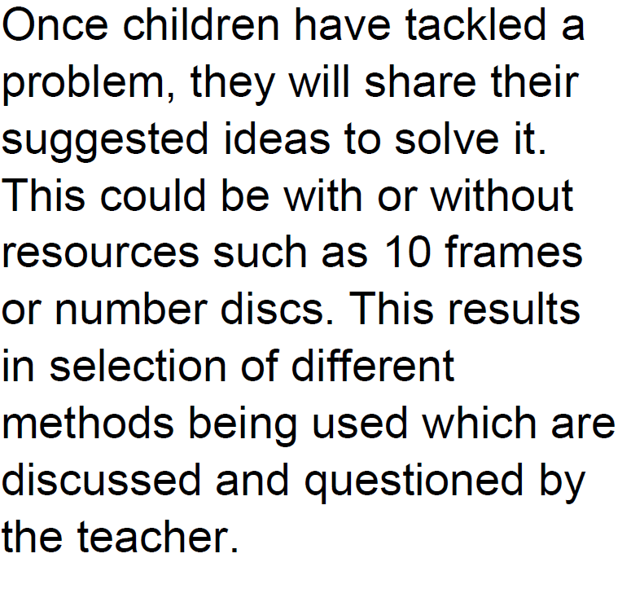
What does the structure of a lesson look like?
Challenge
Plenary Bubble

Slide 15
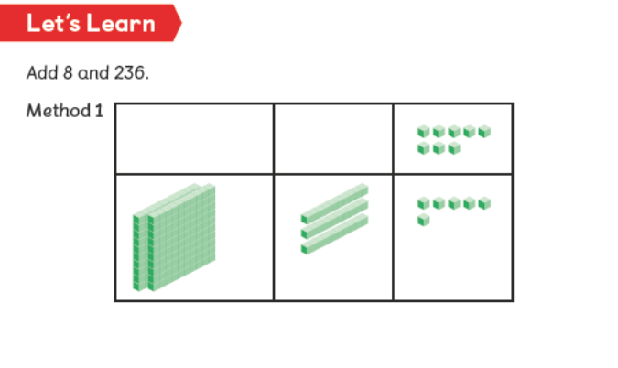
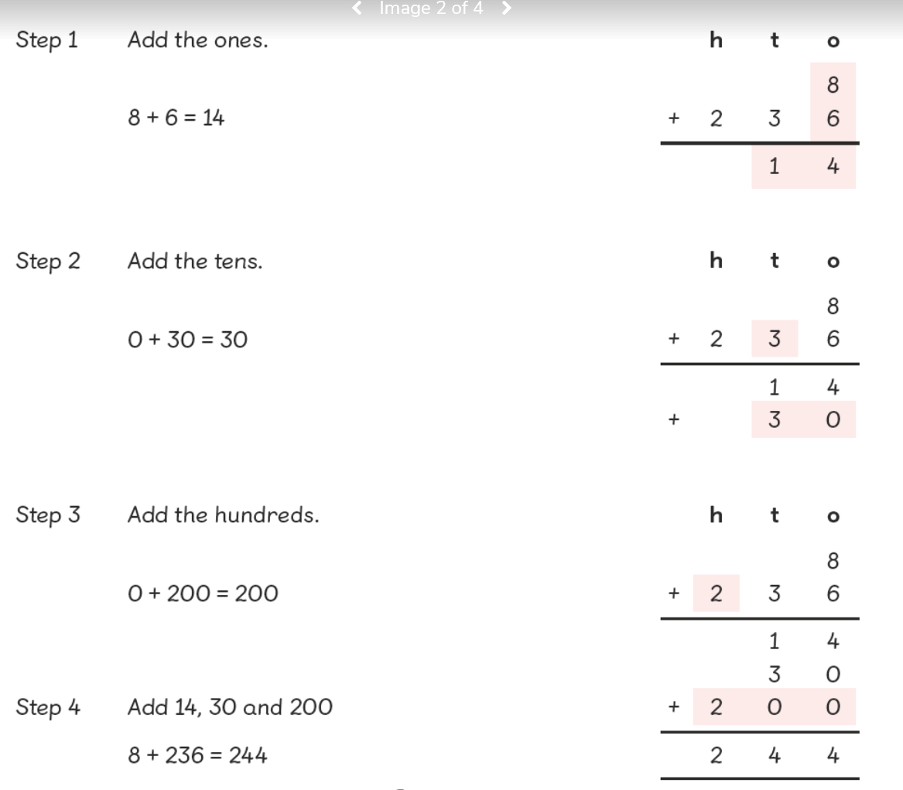

Slide 16
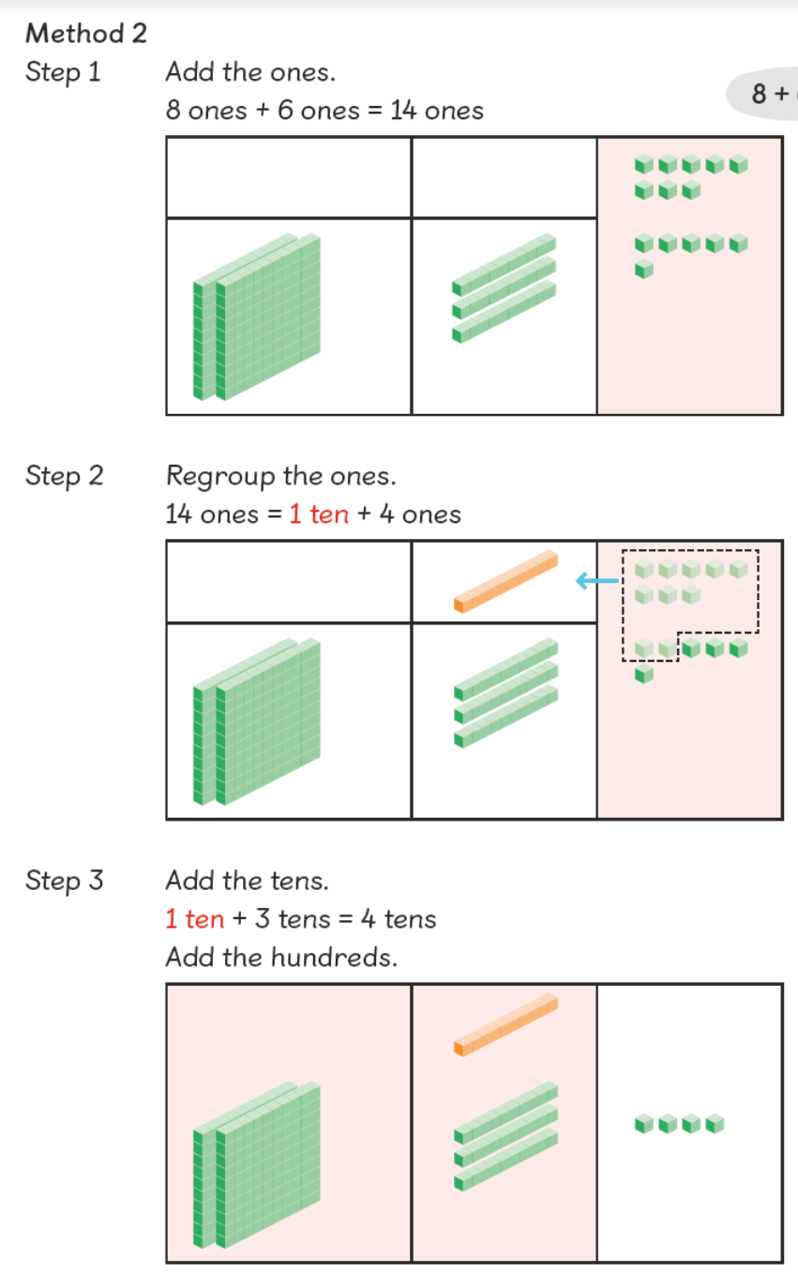


Slide 17
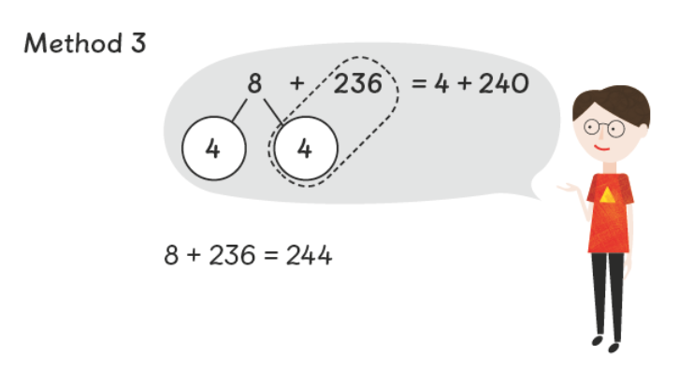

Slide 18
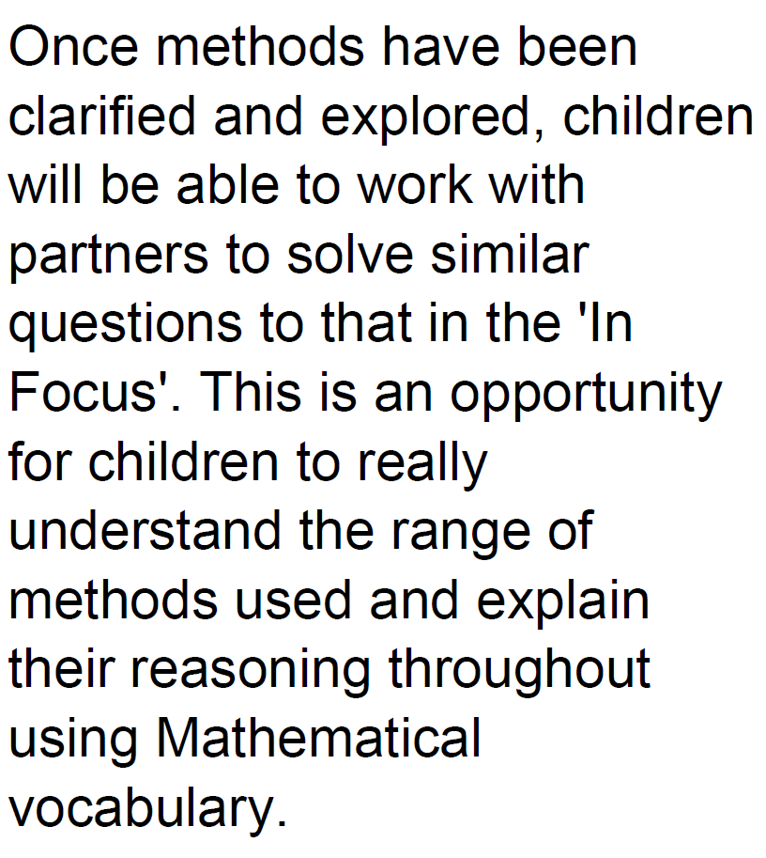
What does the structure of a lesson look like?
Challenge
Plenary Bubble

Slide 19
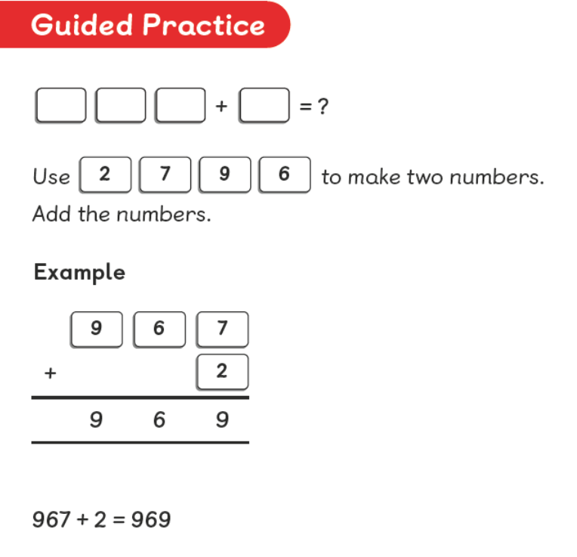

Slide 20
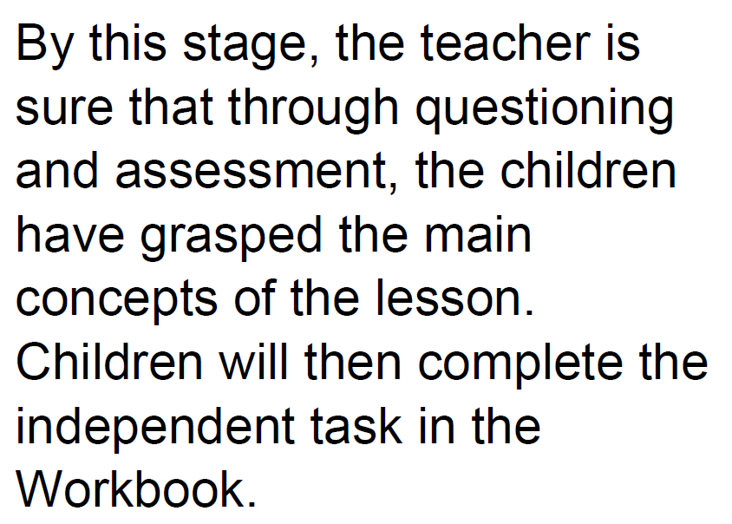
What does the structure of a lesson look like?
Challenge
Plenary Bubble

Slide 21
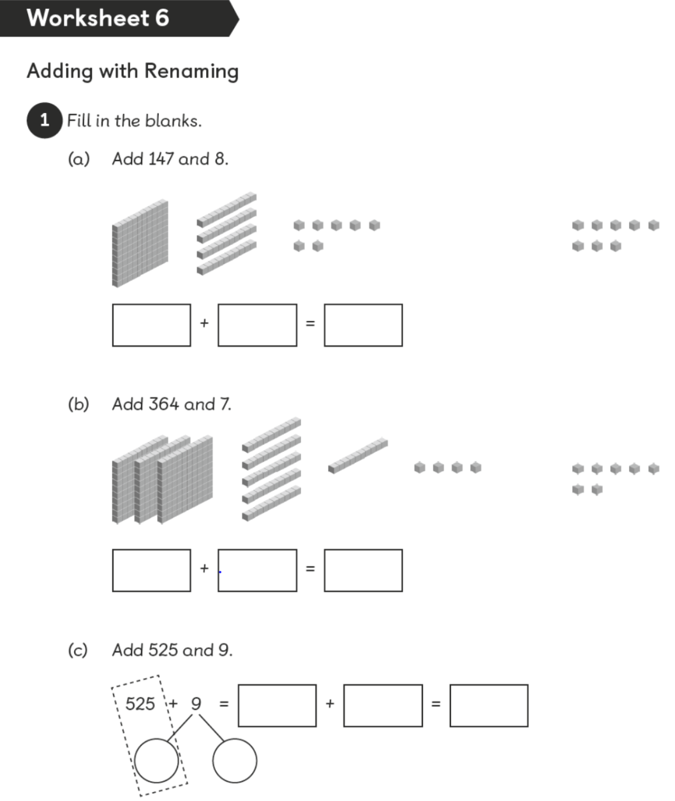
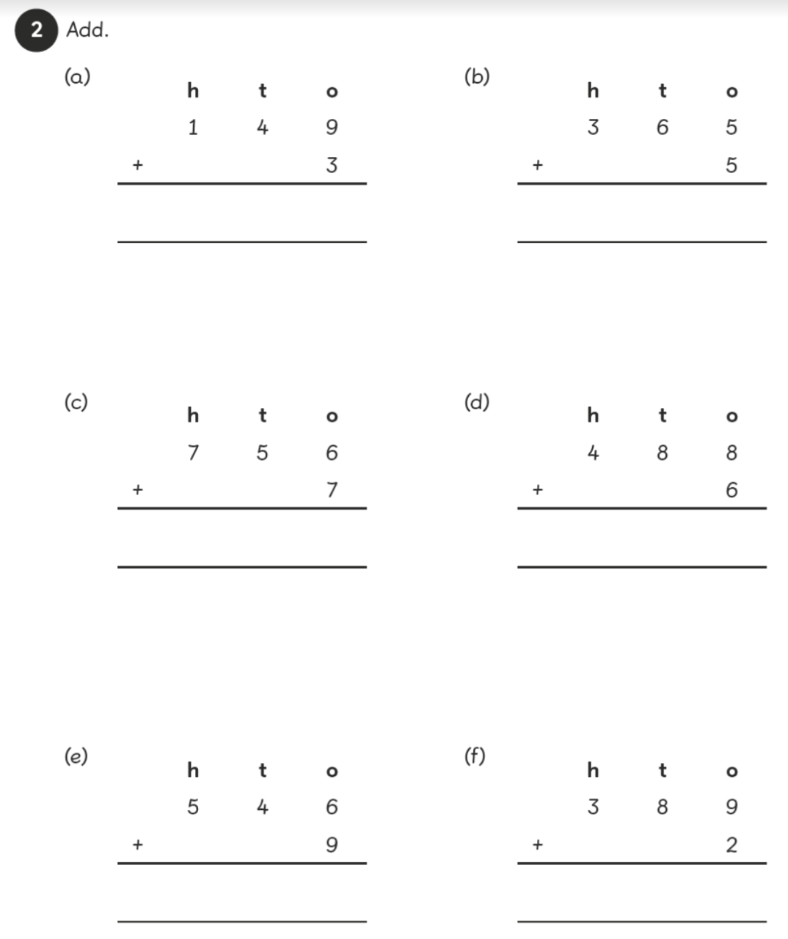

Slide 22
What does the structure of a lesson look like?
A challenge is planned for every lesson and available for all children to complete. A challenge may be a problem solving or reasoning activity that will require the children to go deeper still in their learning and understanding.
Challenge
Plenary Bubble

Slide 23
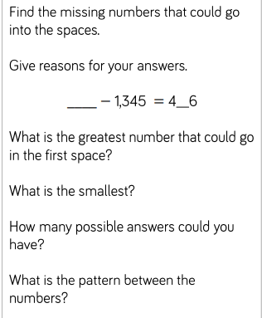
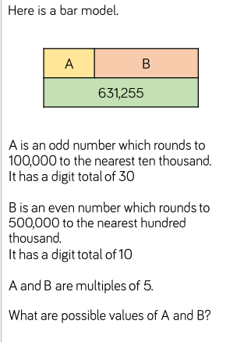
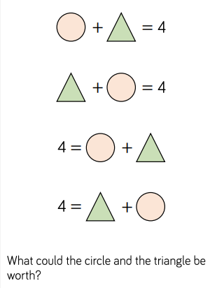
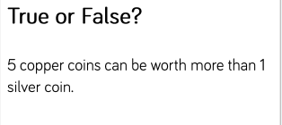
Greater Depth

Slide 24
What does the structure of a lesson look like?
A plenary bubble is planned for the children to reflect on what they have learnt and what skills they have used in the lesson. The problem will relate to their learning and is something at all children should be able to access.
Challenge
Plenary Bubble

Slide 25




@TTRockStars
ttrockstars.com

Slide 26
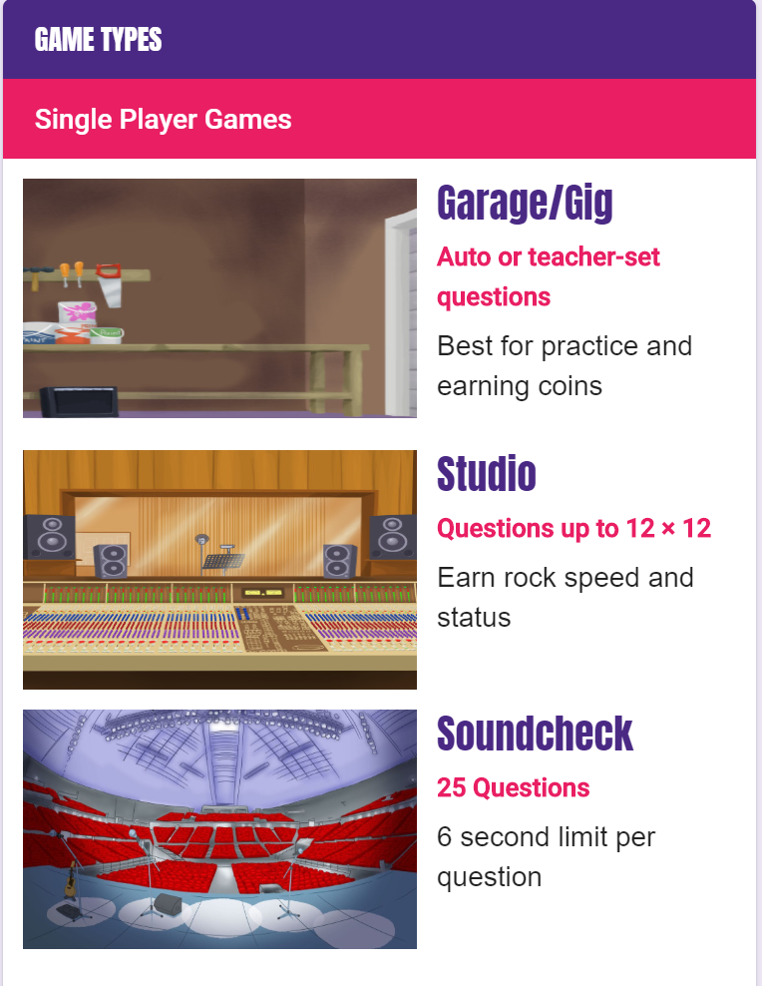

Online Game Types

Slide 27



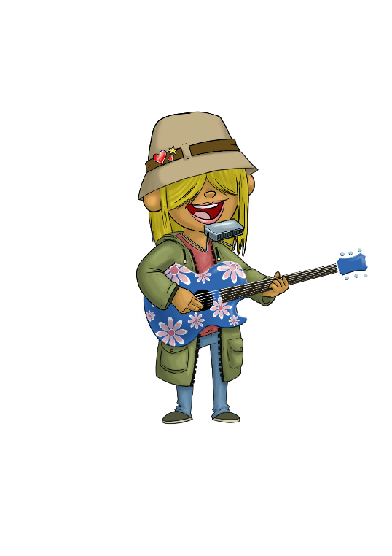








Rock speed
(seconds per question)
Rock Star
3 seconds/question
Rock Hero
one second
per question
Breakthrough Artist
6 seconds/question
Garage Rocker
10 seconds/question
Support Act
5 seconds/question
Busker
9 seconds/question
Unsigned Act
7 seconds/question
Rock Legend
2 seconds/question
Gigger
8 seconds/question
Wannabe
+10 seconds/question
Headliner
4 seconds/question
@TTRockStars
ttrockstars.com
Total Time
÷
Total Score

Slide 28



















Website
•
1 minute games
Single player
Or
Multi-player
Earn & spend on your avatar
@TTRockStars
ttrockstars.com

Slide 29

Thank you
Please complete the questionnaire and return it to school by Friday 29th November 2019.

